Slide 1
How to deploy on AWS EC2 using ECS and GitHub Actions
Fabian Zeiher (zeiher@kth.se)
Iosif Koen (iosif@kth.se)

Slide 2
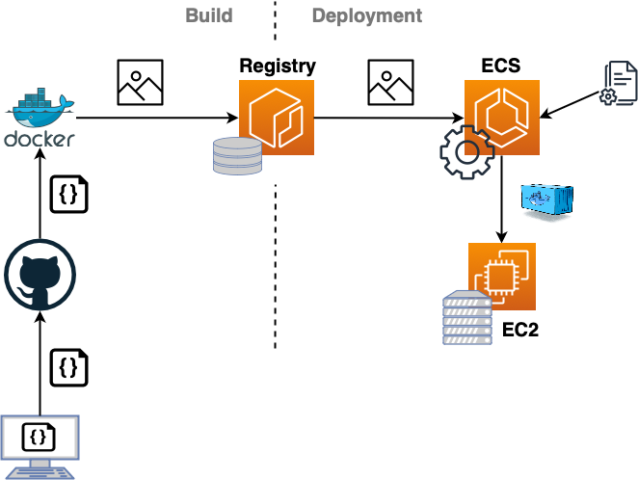
The Pipeline

Slide 3
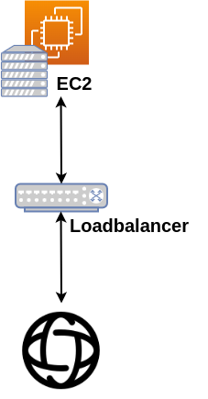
Loadbalancer

Slide 4
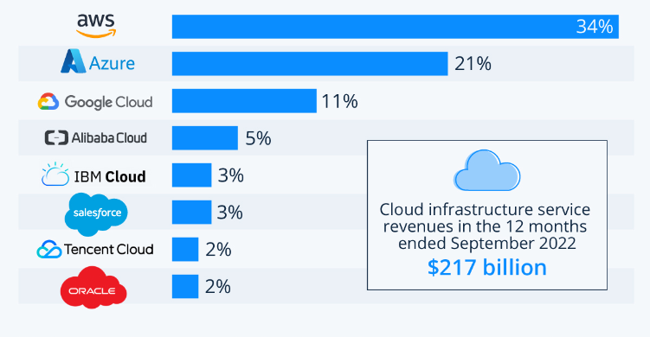
Market Share
Link: https://www.statista.com/chart/18819/worldwide-market-share-of-leading-cloud-infrastructure-service-providers/

Slide 5

Deploy, Deploy, Riders of DevOps Course!
keyboards shall be shaken, mouses shall be splintered, a sword-day, a red day, and the sun rises!
Deploy now, deploy now, deploy!
Deploy for ruin and the world's ending!
Death! Death! Death!
Forth Eorlingas!
AWS cloud is here
We need load balancer

